Slide 1
Fake news detection using nlp
Abstract
Introduction
Deep learning models

Slide 2
a b s t r a c t :
Fake news is a topic that has been discussed for quite some time. Prior to the internet era, it was mostly distributed through yellow journalism, with a focus on sensational news such as crime, rumours, accidents, and amusing news. To rescue the life of people from these fake news propagation, detection of fake news at an early stage becomes the most crucial step. People unknowingly propagate fake news and become a part of fake news propagation. While the original fake news propagators are the one with their aim to target innocent people for spreading the fake news. To stop this series of events, fake news detection and its pattern of propagation becomes very essential to society and the government. Various techniques exist to detect fake news in social media, among which neural networks have shown effective results. A LSTM neural network has been used to build the proposed model. Besides the neural network, a glove word embedding has been used for vector representation of textual words. Also, for feature extraction or vectorization, tokenization technique has been used. N-grams concept is used to enhance the proposed model

Slide 3
Introduction :
The various social media platforms such as Twitter, Facebook, Instagram, etc. have become very popular since they facilitate the easy acquisition of information and provide a quick platform for information sharing .The availability of unauthentic data on social media platforms has gained massive attention among researchers and become a hot-spot for sharing fake news . Fake news has been an important issue due to its tremendous negative impact , it has increased attention among researchers, journalists, politicians and the general public. In the context of writing style, fake news is written or published with the intent to mislead the people and to damage the image of an agency, entity, person, either for financial or political benefits . Few examples of fake news are shown in .
These examples of fake news were in trending during the COVID-19 pandemic and 2016 U.S. General Presidential Election.

Slide 4

These examples of fake news were in trending during the COVID-19 pandemic and 2016 U.S. General Presidential Election.

Slide 5
Advanced technique in deep learning models for fake news detection accuracy:
LSTM (Long Sort Term Memory).
BERT (Bidirectional Encoder Representation from Transformers).
CNN (Convolutional Neural Network)
Boosted trees.
Dataset Link: https://www.kaggle.com/datasets/clmentbisaillon/fake-and-real-news-dataset

Slide 6
LSTM:
LSTM stands for long short-term memory networks, used in the field of Deep Learning. It is a variety of recurrent neural networks (RNNs) that are capable of learning long-term dependencies, especially in sequence prediction problems. LSTM has feedback connections, i.e., it is capable of processing the entire sequence of data, apart from single data points such as images. This finds application in speech recognition, machine translation, etc. LSTM is a special kind of RNN, which shows outstanding performance on a large variety of problems.

Slide 7
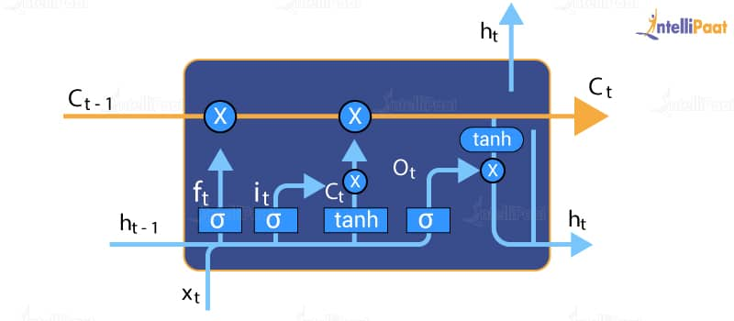
The Logic Behind LSTM
The central role of an LSTM model is held by a memory cell known as a ‘cell state’ that maintains its state over time. The cell state is the horizontal line that runs through the top of the below diagram. It can be visualized as a conveyor belt through which information just flows, unchanged.
The Logic Behind LSTM :
The central role of an LSTM model is held by a memory cell known as a ‘cell state’ that maintains its state over time. The cell state is the horizontal line that runs through the top of the below diagram. It can be visualized as a conveyor belt through which information just flows, unchanged.

Slide 8
LSTM Applications :
LSTM networks find useful applications in the following areas:
Language modeling
Machine translation
Handwriting recognition
Image captioning
Image generation using attention models
Question answering
Video-to-text conversion
Polymorphic music modeling
Speech synthesis
Protein secondary structure prediction

Slide 9
BERT:
BERT is an open source machine learning framework for natural language processing (NLP). BERT is designed to help computers understand the meaning of ambiguous language in text by using surrounding text to establish context. The BERT framework was pre-trained using text from Wikipedia and can be fine-tuned with question and answer datasets.
BERT, which stands for Bidirectional Encoder Representations from Transformers, is based on Transformers, a deep learning model in which every output element is connected to every input element, and the weightings between them are dynamically calculated based upon their connection. (In NLP, this process is called attention.)

Slide 10
BERT works :
The goal of any given NLP technique is to understand human language as it is spoken naturally. In BERT's case, this typically means predicting a word in a blank. To do this, models typically need to train using a large repository of specialized, labeled training data. This necessitates laborious manual data labeling by teams of linguists.
BERT, however, was pre-trained using only an unlabeled, plain text corpus (namely the entirety of the English Wikipedia, and the Brown Corpus). It continues to learn unsupervised from the unlabeled text and improve even as its being used in practical applications (ie Google search). Its pre-training serves as a base layer of "knowledge" to build from. From there, BERT can adapt to the ever-growing body of searchable content and queries and be fine-tuned to a user's specifications. This process is known as transfer learning.

Slide 11
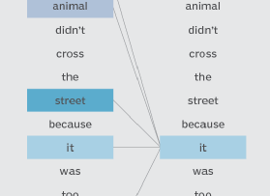
BERT CHART:
BERT is also the first NLP technique to rely solely on self-attention mechanism, which is made possible by the bidirectional Transformers at the center of BERT's design. This is significant because often, a word may change meaning as a sentence develops. Each word added augments the overall meaning of the word being focused on by the NLP algorithm. The more words that are present in total in each sentence or phrase, the more ambiguous the word in focus becomes. BERT accounts for the augmented meaning by reading bidirectionally, accounting for the effect of all other words in a sentence on the focus word and eliminating the left-to-right momentum that biases words towards a certain meaning as a sentence progresses.

Slide 12
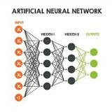
CNN:
CNN is a type of artificial neural network, which is widely used for image/object recognition and classification.

Slide 13
Boosting TREES :
Boosting means that each tree is dependent on prior trees. The algorithm learns by fitting the residual of the trees that preceded it. Thus, boosting in a decision tree ensemble tends to improve accuracy with some small risk of less coverage.

Slide 14
Conclusion :
The focal point of our research lies in differentiating and detecting fake news and original or real news. The goal of this study is to determine and comprehend the impact of fake news on the government and society. This research aims in helping society from the spread of fake news, making people aware of the fake news propagators and their expansion in today’s world. As a result, the spread of fake news has been a hot topic for quite some time. The primary obligation for the betterment of society is to detect fake news. The proposed model used a deep learning framework, which makes use of neural networks and the long short-term memory architecture.
This neural network model has been presented to improve the detection of misleading news. Before training the model, the concept of stopwords has been employed for data preprocessing, which enhances the accuracy of the model. A tokenization method has been proposed for feature extraction or vectorization, which assigns tokens to word embeddings. The GloVe technique was used to represent each word in vector form for word embeddings

Slide 15
The information then passes via the main LSTM neural network, where it is routed through various levels in the architecture. The long short -term memory model is used for the construction of the model which mainly is based on the concept of classification of data for sequential prediction. Finally, the model is programmed to distinguish between true and false news. The evaluation metric of the proposed model is accuracy. Our proposed model achieved 99.88% accuracy. The future direction lies to improvise and outstretch the existing work for implementation of existing work towards building an automated system for e-commerce websites, where detection of fake news has become equally important.

Slide 16


